Slide 1


SELECTED 2 PROJECT
MULTI-CLASS CLASSIFICATION
MULTI-CLASS CLASSIFICATION OF ALZHEIMER'S DISEASE

Slide 2
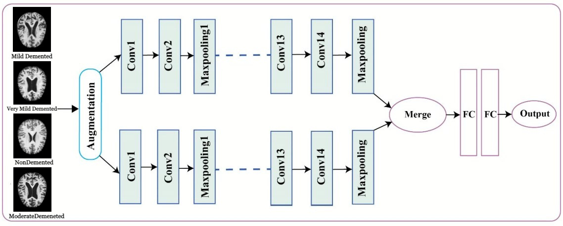
THE ARCHITECTURE USED IN THE PAPER:

Slide 3

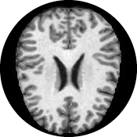
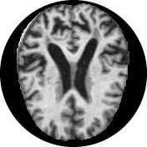
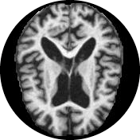
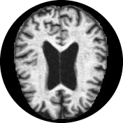
DATASET DETAILS:
  1
  1
The name of the dataset used:
  2
  3
ALZHEIMER'S DATASET
The link of the dataset:
https://www.kaggle.com/datasets/tourist55/alzheimers-dataset-4-class-of-images
Number of classes :
  4
( 4 CLASSES OF IMAGES)
Dataset consists of two files :
Training and Testing both contain a total of around ~5000 images each segregated into the severity of Alzheimer'sfour calasses
  5
The labels of our classes :
VERY MILD DEMENTED
NON DEMENTED
MILD DEMENTED
MODERATE DEMENETED

Slide 4
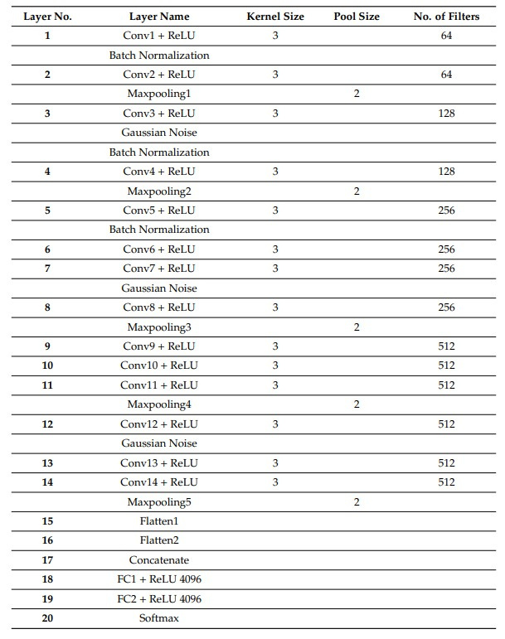
THE DESIGN OF OUR NETWORK:

Slide 5
Implementation Details
We have used 31 layers (input,14Conv,3BatchNormalization,5 MaxPool,2Gaussian noise,3 Drop out 2flatten,2 FC)

Slide 6
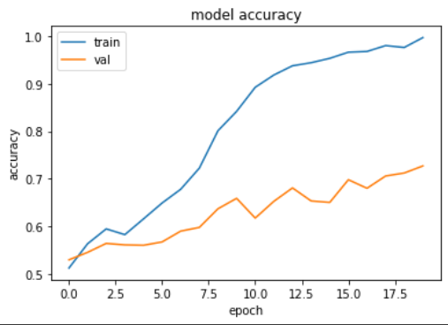
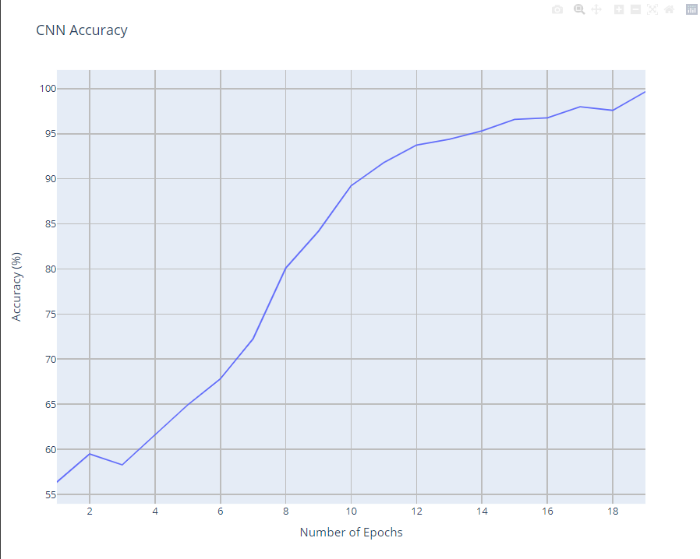
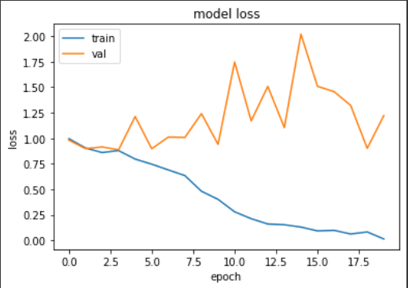
Results Details
Accuracy: 99.6%
Validation accuracy: 72.7%

Slide 7
MULTI-CLASS CLASSIFICATION OF ALZHEIMER DISEASE
THANK YOU!

